Slide 1

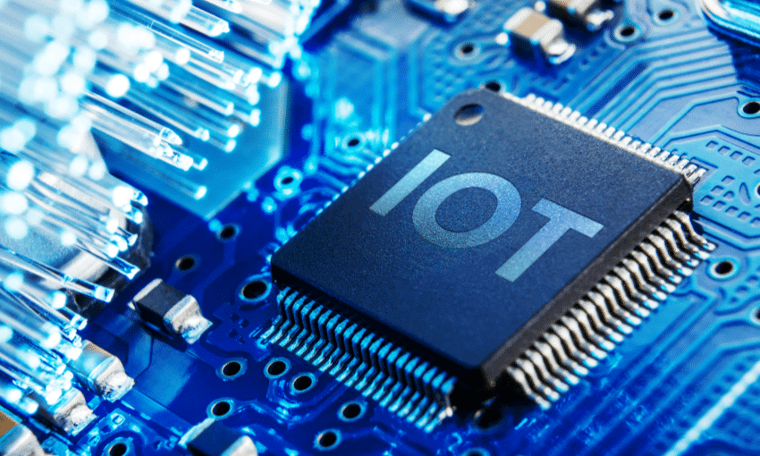
IOT PROJECT
Air Pollution Monitoring and Purification
Instructor- Dr. Kavita Jaiswal
Group Members:
Aditya Raj – 221010203
Om Prakash – 221010233
Vikas Patel – 221010258
This Photo by Unknown Author is licensed under CC BY-SA

Slide 2
Introduction
IoT is a network of interconnected devices that collect, share, and analyze data in real-time, enabling us to make informed decisions and take proactive actions. In the context of air pollution monitoring and purification, IoT offers several advantages over traditional methods.
IoT-enabled air pollution monitoring devices can collect real-time data on various air quality parameters, such as particulate matter, hazardous gases of a particular area where we can monitor the air and control accordingly.

Slide 3
Air Monitoring and Purification Abstract: Purpose and Requirements
Without pure air there is decrease in life span and also it affects the productivity of life.
Now the technology is so advanced so people have to be smart and also think about health and be efficient. Environmentalist used different methods for removing air pollution and apply all three R( Reuse, Recycle, Reduce) methods to purify the atmosphere.
Development and use of proper technology to overcome the air pollution and by using internet user can access remotely to monitor and purify the air.

Slide 4
Domain Model Specification
The Project is based on Arduino with several sensors, LCD display and wi-fi module.
The system consist of several sensors used to monitor the air such as : MQ135, MQ6, Humidity Sensor, LM35 which has several functions.
After the information from these sensors it measure the quality of impure gases in the air where the system monitor and purify air by blower fan.
Use of ESP32 which is wi-fi module interlink the hardware and software where public can handle remotely.
Creating a proper model of internal space where people can monitor the air. Buzzer is also used in the system where at a proper instant it will beep and after a certain amount the blower fan automatically blow. It can also be handled the blower fan by switch and the website.

Slide 5
Basic Components Description
Breadboard & Jumper Wires – Basic components of any system. It can be said as The platform and Transportation respectively.
Arduino Uno – Based on an open-source microcontroller board can be programmed using a simple, user-friendly interface.
ESP32 - ESP32 is a powerful and versatile microcontroller that is well-suited for a wide range of IoT applications. Its dual-core processing, built-in Wi-Fi and Bluetooth connectivity, and compatibility with a variety of sensors and peripherals.
LCD Display - The LCD 16x2 module typically includes a backlight and a driver circuit, which can be controlled by a microcontroller to display text and graphics.

Slide 6
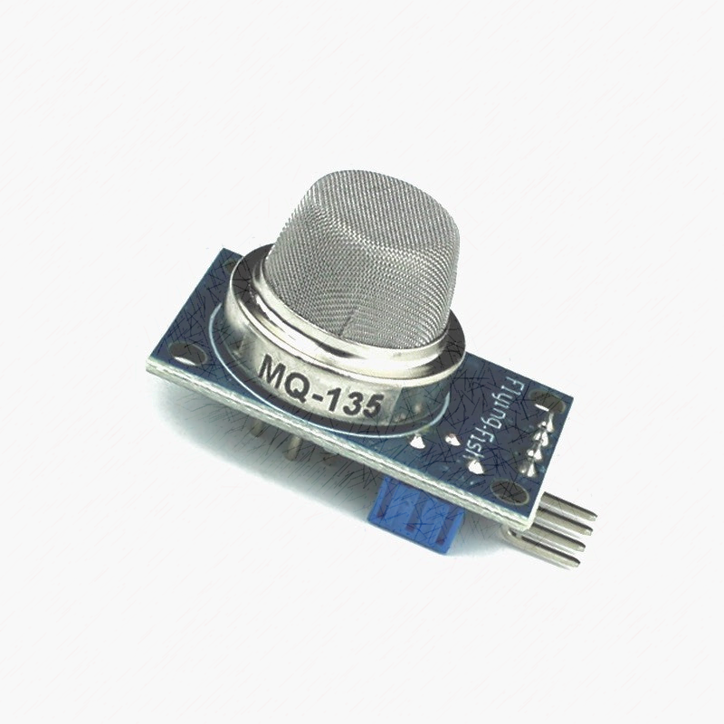
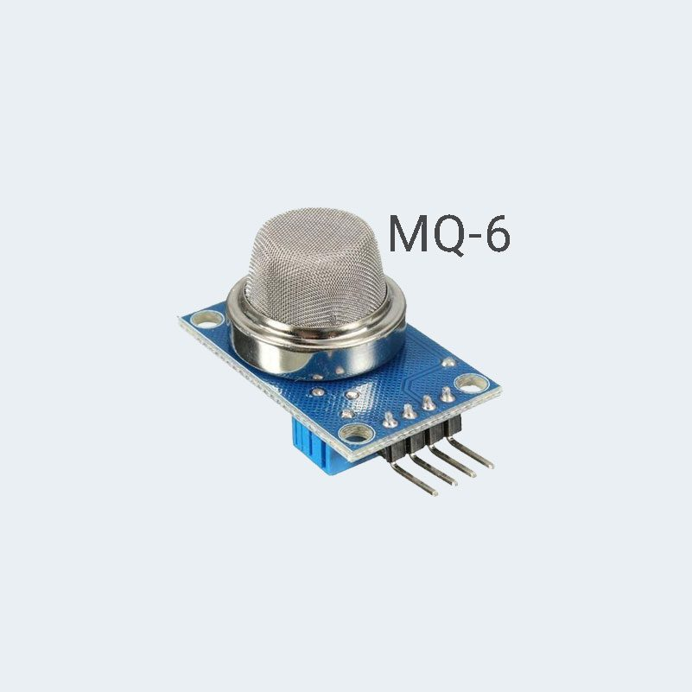
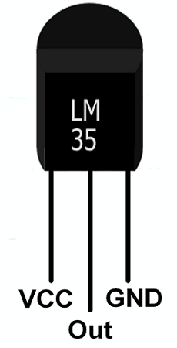
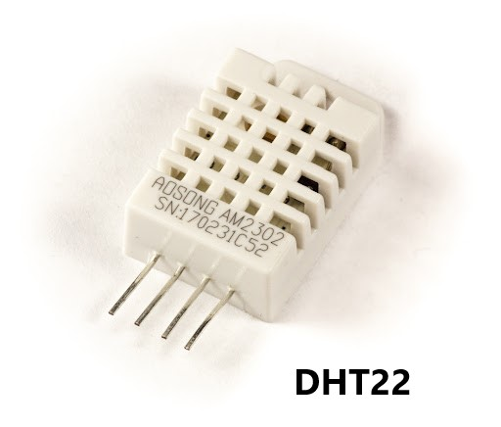
Sensors Used
MQ135 - The MQ135 module is commonly used in air quality monitoring applications, such as indoor air quality (IAQ) monitoring, outdoor pollution monitoring, and gas leak detection(ammonia, nitrogen oxides, and benzene). It is a type of semiconductor sensor that changes its resistance in response to the presence of specific gases.
MQ6 - It is designed to detect the presence of flammable gases, such as propane, butane, and methane.
LM35 - LM35 is a temperature sensor module that is designed to measure the temperature of its surrounding environment with high accuracy.
Humidity Sensor(DHT22) – It is designed to measure the relative humidity of the surrounding environment.

Slide 7
Output
→Two actuators that use in the system
Buzzer – At a certain level the buzzer will beep it joined it in output pin.
Blower fan – It will flow after buzzer beeps or also act upon it by remotely. Instead of one use two blower fans.
After writing the code in Arduino software compile and execute it then user can see the impurity in serial monitor that is present in the software.
Now the system will join with IoT Analytics - ThingSpeak Internet of Things, Blynk IOT
Here the author join the projects accordingly.

Slide 8
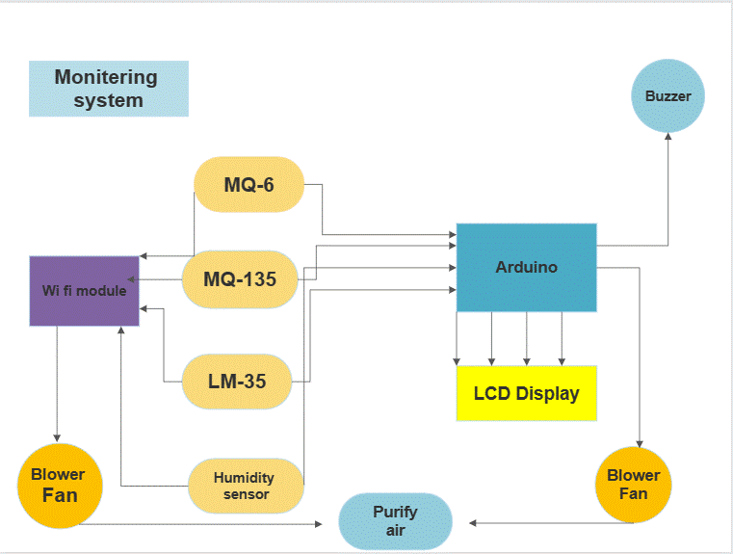

Slide 9
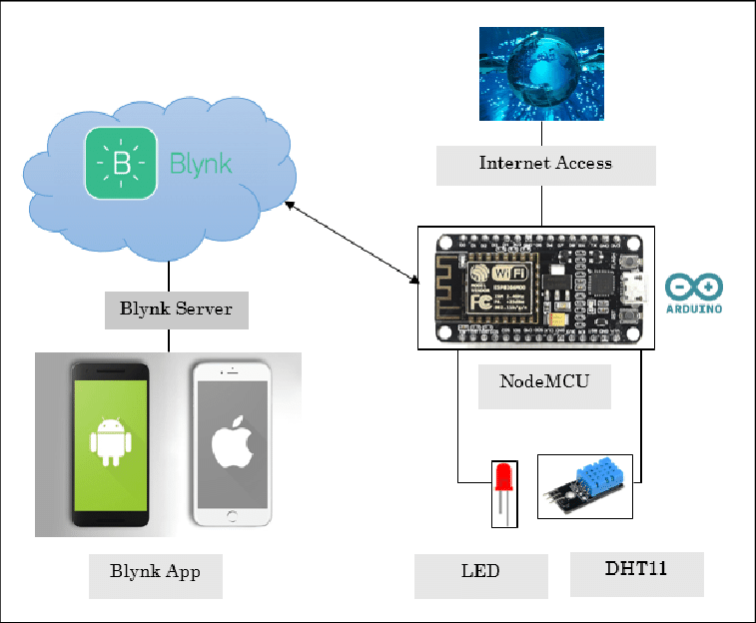
Cloud System (Blynk App)
The ESP32 can be easily integrated with ThingSpeak to send sensor data to the cloud and analyze it. Here's how to send data from an ESP32 to ThingSpeak:
Connect the ESP32 to the Wi-Fi network using the built-in Wi-Fi module.
Write the ESP32 code to collect sensor data and send it to ThingSpeak.

Slide 10
Implementation
Setup of hardware is joined according to circuit diagram and all the sensors and the module is joined with the digital pin of Arduino and write the code in Arduino software and execute it.
At this instant the system can monitor the air and user can see the impurities in serial monitor.
Next add the system through wi-fi module in ThingSpeak websites by its IP address where programmer can monitor the system.
At last add blower fan in hardware accordingly into the Arduino software.
Afterward the project will be completed and accordingly and user can monitor and purify indoor air remotely.

Slide 11
Limitation
Users take advantage from the system only in shorter area. The system only purify the indoor air but does not purify outer air pollution only monitor outer area.
For larger area there they have to use an ample amount of sensors which have larger I/O mode. The system is somehow costly.
The system always want electric power for its operation.
The consequences of varying power might destructs the sensors and also there is lost in wi-fi module which fails the system.
The Author can’t identify if the temperature and gas when both receive by the sensors at same time.

Slide 12
Advancement
In the System there also can be addition or develop into fire alarm system by just adding fire sensor and adding water pump.
LPG sensor can sense LPG leakage and by proper use of software user can take action against it.
Without use of ThingSpeak user can create own websites and add the hardware components in it by proper use of IOT system(wi-fi Module).
The system could be improved by integrating machine learning algorithms to predict air quality trends and to identify patterns in the data.

Slide 13
Conclusion
The air pollution monitoring and purifier project with IoT technology is a useful and innovative system that can help monitor and control air pollution in indoor environments. The project makes use of several components such as an Arduino Uno or ESP32 microcontroller, MQ135 and MQ6 gas sensors, and an LCD 16x2 display to detect the levels of pollutants in the air and display the readings in real-time. The system also incorporates a purifier that can remove pollutants from the air.The use of IoT technology in the project allows for remote monitoring and control of the system through a mobile device.

Slide 14
Future Scope
The project has the potential to inspire further development and innovation in the field of air pollution monitoring and control.
The project could be further enhanced by integrating it with cloud-based services such as AWS, Azure or Google Cloud. This would enable the system to store data, generate reports, and perform analytics on the air quality data.

Slide 15
THANK YOU

Slide 16
The feedback form consists of several input fields such as name, email, subject, faculty, and comment. These fields are created dynamically using Tkinter's widgets, ensuring a flexible and scalable design. The form allows students to select a subject from a dropdown menu and enter their feedback comments in a text area.
Upon submission of the form, the entered data is collected and displayed in the console for processing. A message box is also displayed to thank the student for their feedback.
The project incorporates concepts such as encapsulation, where the form's widgets are encapsulated within a class, promoting code modularity and reusability. The use of abstraction is demonstrated through the dynamic creation of input fields, reducing code redundancy and enhancing maintainability.

